Slide 1



VR Headset Protector
By: Cesar De La Cruz, Alejandro De La Cruz, Gemaris Velazquez, Jonathan A. Corrigeux
Cody Burkhart – NASA Engineer, VR Division
Nathanial Wiggins – Mathematics professor, San Jacinto College. Principal Investigator of Artificial Intelligence Technology Labs.

Slide 2
Problem Statement
Augmented reality (AR) is implemented in the training regime for astronauts to prepare for the environmental conditions of space.
A culprit in the malfunction of the internal components of the virtual reality headsets is sweat.
The VR Wearable technology team aims to create a cost-effective design implementing Arduino sensors and certain fabrics surrounding the headset to mitigate sweat secretion while not sacrificing mobility, comfort, or time.
Sweat will be detected as it reaches a critical level where the internal components can be potentially compromised.

Slide 3
Design Requirements
Inexpensive and Reusable
Must not limit Mobility
Materials used must not release more than the acceptable levels of outgases
Easy to Sanitize

Slide 4
Technology & Hardware
Parts Used:
FC-37 Rain Sensor- Detects Water
KY-016 3-color LED module- Light
Buzzer
DHT11 Humidity and Temperature Sensor
Arduino Nano- Intelligence Chip
Breadboard
3 AAA Battery Compartment
Cooling Mask

Slide 5
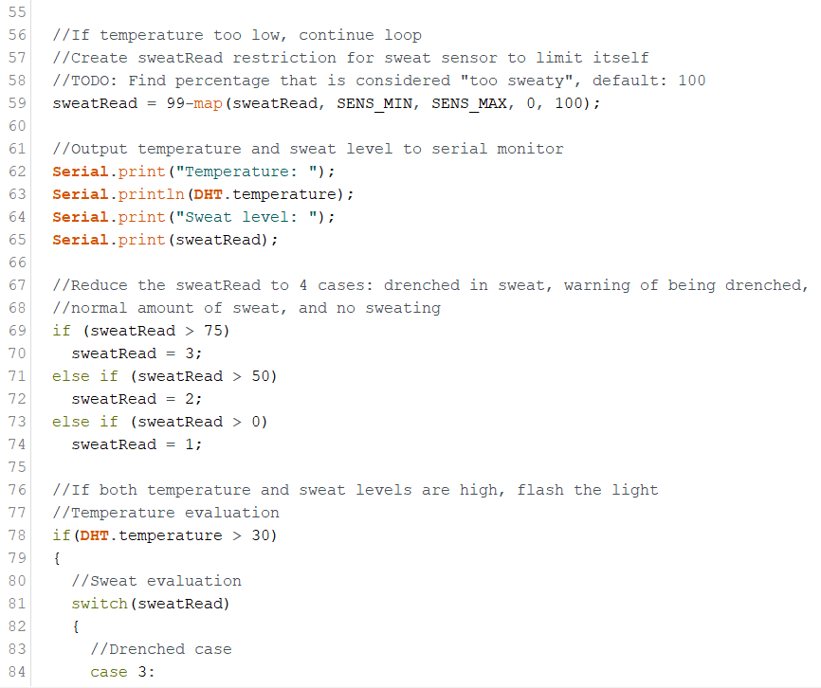
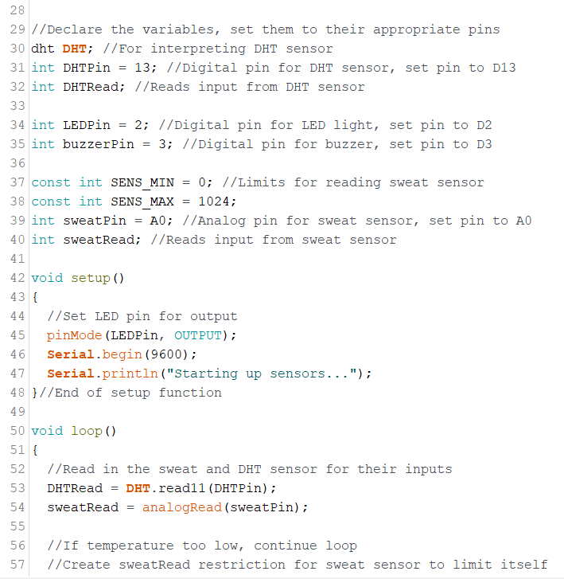
Software

Slide 6
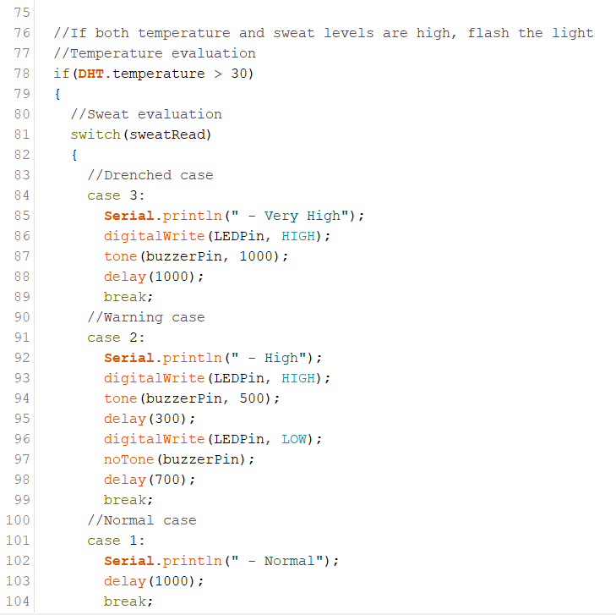
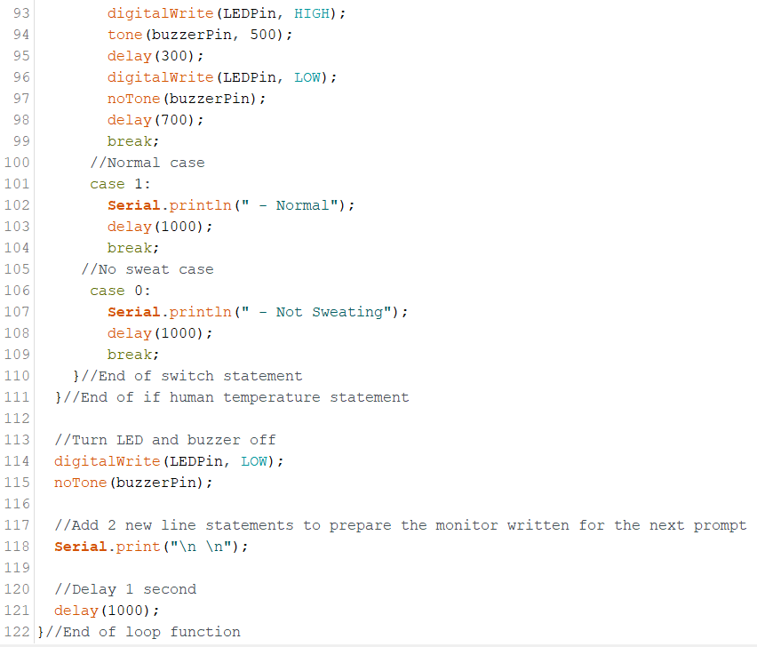
Continued...

Slide 7
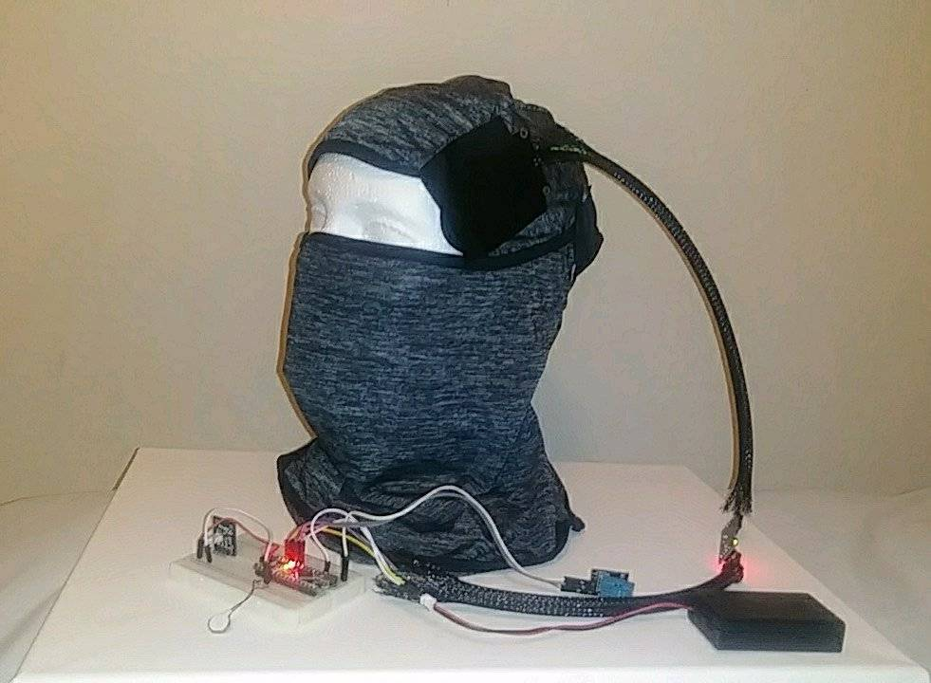
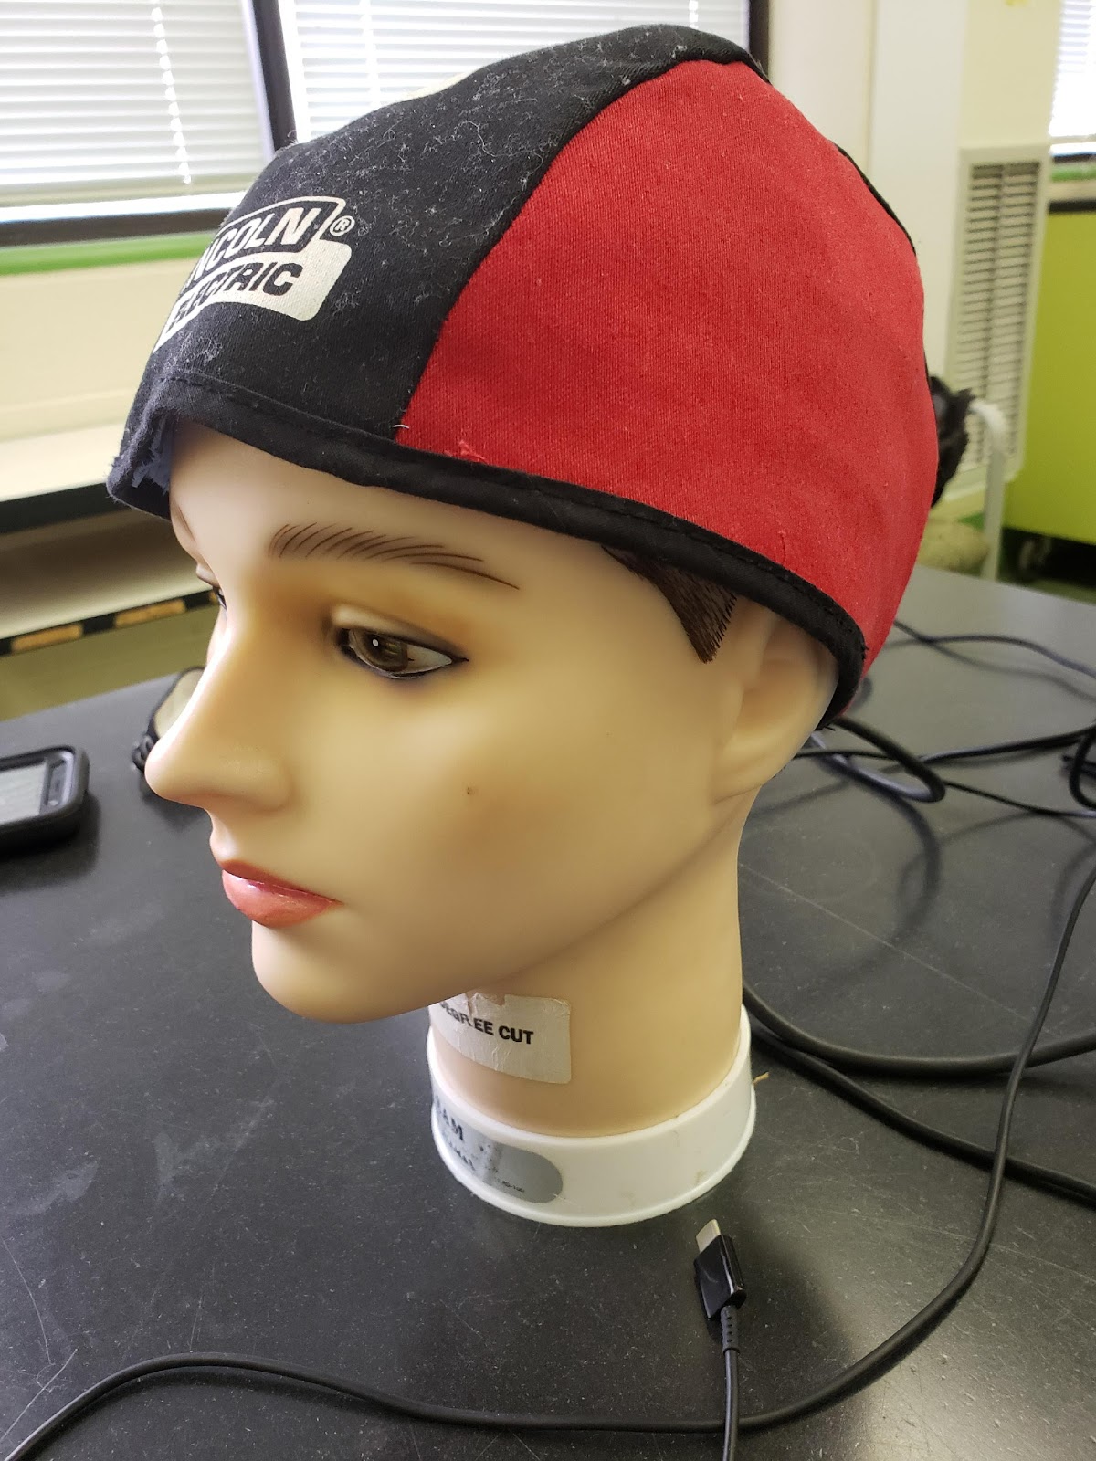
Analysis
REQUIREMENTS | OUR HEADSET | SWEAT GLADIATOR (Previous Team) | Just with VR Headset
Inexpensive & Reusable | 2 | 2 | 0
Must Not Limit Mobility | 2 | 1 | 2
Does Not Cause Outgassing | 2 | 2 | 2
Kills 95% of Bacteria | 1 | 1 | 0
numbers | Requirements
2 | Exceed the requirements
1 | Pass the requirements
0 | Failed the requirements

Slide 8
Conclusion
A Cooling Mask that can hold sweat with sensors that can warn the user when they are in danger of breaking the VR system is an incredible breakthrough. The device can let astronauts train longer without fear of damaging the technology. The device can also test the body. This can help in the medical field to learn more about the body while training, along with in space to learn about the effect of long periods of time in space on the human body. As more studies occur, there will be more research on better materials to use at a cheaper price. Continued testing will also allow the device to be as efficient in collecting sweat and cooling the user as possible.

Slide 9
Acknowledgments
Professor Wiggins- For guiding the team in the right direction and for providing our supplies.
Cody(NASA Employee)- For giving the team information about VR headsets and what NASA had already tried to solve the issue but failed
Previous Team: Josue Zuniga- VR teams' leader, Shane Martin- VR teams 2nd in Command/lead designer/Researcher, Osvaldo Rodriguez- Hardware/Software researcher, Arnold Garcia- Hardware researcher, Diana Thomas- Technical Writer
Shane Martin(Vynckier Intern)- offered a place to work at, gave feedback, and gave points on how to present.

Slide 10
References
Bull, G. W. (2008, April 1). Cold Towels Valuable Rehab Tools. Retrieved April 28, 2019, from https://www.fireengineering.com/articles/print/volume-161/issue-4/features/cold-towels-valuable-rehab-tools.html
Corbett, J. (2017, August 6). Toxic Offgassing. Retrieved from https://www.nasa.gov/centers/wstf/testing_and_analysis/materials_flight_acceptance/toxic_offgassing.html
Hall, J. E. (2016). Guyton and Hall Textbook of Medical Physiology (11th ed.). Philadelphia,PA: Elsevier.
Honest. (2014, January 29). What Is Polyvinyl Alcohol? Retrieved April 28, 2019, from https://blog.honest.com/polyvinyl-alcohol/
NASA JSC. (2019). Wearable Technologies Workshop. Retrieved April 28, 2019, from https://techcollaboration.center/wp-content/uploads/Workshops/WT_2019/Challenges/TCC_WT2019_Challenge-NASAJSC-VIVEVRSweatProtectionSensorCapability.pdf
Outgassing Test Facility Brings New Materials into Space Industry. (n.d.). Retrieved from https://spinoff.nasa.gov/Spinoff2017/ip_8.html
Reede, E., & Bailiff, L. (2016). When Virtual Reality Meets Education. Retrieved April 28, 2019, from https://techcrunch.com/2016/01/23/when-virtual-reality-meets-education/
Rose, D. P., Ratterman, M., Griffin, D. K., Hou, L., Kelley-Loughnane, N., Naik, R. R., . . . Heikenfeld, J. (2014, November 6). Adhesive RFID Sensor Patch for Monitoring of Sweat Electrolytes. Retrieved April 28, 2019, from DOI 10.1109/TBME.2014.2369991
Goldfox Balaclava Face Mask, Retrieved july 10,2019 fromhttps://www.amazon.com/Balaclava-Protection-Incredibly-Breathable-Motorcycle/dp/B07R3JGDB6

